Slide 1
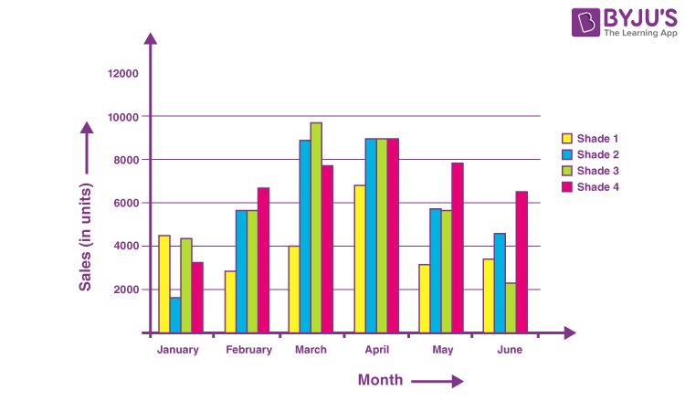
BAR CHART

Slide 2
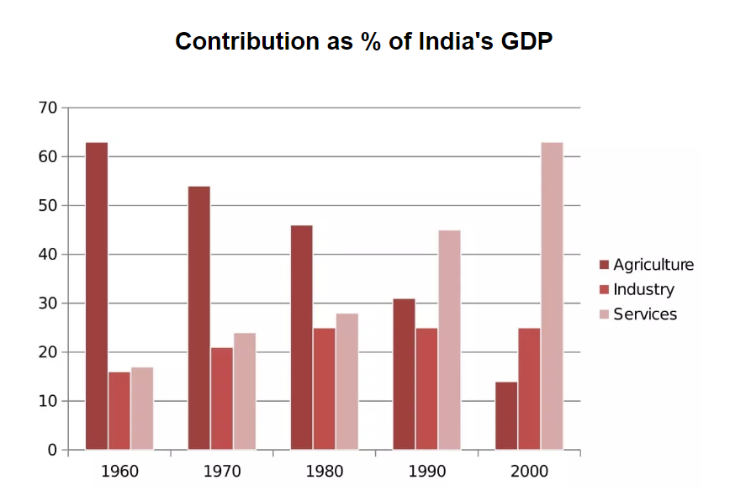
The bar chart below shows the sector contributions to India’s gross domestic product from 1960 to 2000.
Summarise the information by selecting and reporting the main features, and make comparisons where relevant.
Write at least 150 words.

Slide 3
SAMPLE ANSWER
The bar graph illustrates the relative percentage contributions made by the agricultural, industrial and service sectors to the Indian economy between 1960 and 2000. Over the whole time period, the significance of agriculture declined steadily while services grew in importance decade by decade. A different pattern emerged for industry, which initially showed a slowly increasing percentage but then plateaued from 1980 onwards.
In 1960, agriculture contributed by far the highest percentage of GDP, peaking at about 62%, but it then dropped in steady increments to a low of almost 12% in 2000. The service sector, on the other hand, had a relatively minor impact on the economy in 1960. This situation changed gradually at first, then its percentage contribution jumped from around 28% to about 43% between 1980 and 1990. By 2000 it matched the high point reached by agriculture in 1960, showing a reversal in the overall trend.
Industry remained a steady contributor to India’s wealth throughout the period. As a sector, it grew marginally from about 16% in 1960 to around a quarter in 1980 then remained static for the next two decades, maintaining a constant share of the overall GDP.
(188 words)

Slide 4
BREAKDOWN AND EXPLANATION

Slide 5
Bar Chart
Before we begin, here’s a model structure that you can use as a guideline for all IELTS Academic Task 1 questions.
Ideally, your writing should have 3 paragraphs:
Paragraph 1 – Introduction+Overview
Paragraph 2 – 1st main feature
Paragraph 3 – 2nd main feature

Slide 6
Analyse the question
The bar chart shows the sector contributions to India’s gross domestic product from 1960 to 2000.
Summarise the information by selecting and reporting the main features, and make comparisons where relevant.

Slide 7
The bar chart below shows the sector contributions to India’s gross domestic product from 1960 to 2000.
Summarise the information by selecting and reporting the main features, and make comparisons where relevant.
Write at least 150 words.
Every question consists of:
Sentence 1 – A brief description of the graphic
Sentence 2 – The instructions
The graphic – chart, graph, table, etc.
Sentence 2 tells you what you have to do.
You must do 3 things:
1. Select the main features.
2. Write about the main features.
3. Compare the main features.

Slide 8
Identify the Main Features
What information do the 2 axis give?
Is it dynamic or static?
What are the units of measurements?
What are the time periods?
What can you learn from the title and any labels?
What is the most obvious trend?
Are there any notable similarities?

Slide 9
Identify the Main Features
Main feature 1: The contribution of the agricultural sector dropped steadily.
Main feature 2: The contribution of the service sector increased each decade.
Main feature 3: Industry remained static from 1980 to 2000.

Slide 10
Write an Introduction
Question:
The bar chart below shows the sector contributions to India’s gross domestic product from 1960 to 2000.
Introduction (Paragraph 1):
The bar graph illustrates the relative percentage contributions made by the agricultural, industrial and service sectors to the Indian economy between 1960 and 2000.
DO NOT GIVE ANY HEADING
THE HEADINGS OF THE PARAGRAPHS ARE FOR EXPLANATION ONLY
YOUR WRITING SHOULD ONLY HAVE PARAGRAPHS AS SHOWN IN THE LAST SLIDE

Slide 11
Write an Overview
Main feature 1: The contribution of the agricultural sector dropped steadily.
Main feature 2: The contribution of the service sector increased each decade.
Main feature 3: Industry remained static from 1980 to 2000.
Overview Paragraph-1:
Over the whole time period, the significance of agriculture declined steadily while services grew in importance decade by decade. A different pattern emerged for industry, which initially showed a slowly increasing percentage but then plateaued from 1980 onwards.
DO NOT GIVE ANY HEADING
THE HEADINGS OF THE PARAGRAPHS ARE FOR EXPLANATION ONLY
YOUR WRITING SHOULD ONLY HAVE PARAGRAPHS AS SHOWN IN THE LAST SLIDE
*plateaued-reach a state of little or no change

Slide 12
Paragraph-1 (Intro+Overview)
The bar graph illustrates the relative percentage contributions made by the agricultural, industrial and service sectors to the Indian economy between 1960 and 2000. Over the whole time period, the significance of agriculture declined steadily while services grew in importance decade by decade. A different pattern emerged for industry, which initially showed a slowly increasing percentage but then plateaued from 1980 onwards.
DO NOT GIVE ANY HEADING
THE HEADINGS OF THE PARAGRAPHS ARE FOR EXPLANATION ONLY
YOUR WRITING SHOULD ONLY HAVE PARAGRAPHS AS SHOWN IN THE LAST SLIDE

Slide 13
Write the 1st Detail Paragraph
Main feature 1: The contribution of the agricultural sector dropped steadily.
Main feature 2: The contribution of the service sector increased each decade.
Paragraph 2:
In 1960, agriculture contributed by far the highest percentage of GDP, peaking at about 62%, but it then dropped in steady increments to a low of almost 12% in 2000. The service sector, on the other hand, had a relatively minor impact on the economy in 1960. This situation changed gradually at first, then its percentage contribution jumped from around 28% to about 43% between 1980 and 1990. By 2000 it matched the high point reached by agriculture in 1960, showing a reversal in the overall trend.
DO NOT GIVE ANY HEADING
THE HEADINGS OF THE PARAGRAPHS ARE FOR EXPLANATION ONLY
YOUR WRITING SHOULD ONLY HAVE PARAGRAPHS AS SHOWN IN THE LAST SLIDE

Slide 14
Write the 2nd Detail Paragraph
Main feature 3: Industry remained static from 1980 to 2000.
Paragraph 3:
Industry remained a steady contributor to India’s wealth throughout the period. As a sector, it grew marginally from about 16% in 1960 to around a quarter in 1980 then remained static for the next two decades, maintaining a constant share of the overall GDP.
*Marginally-slightly
DO NOT GIVE ANY HEADING
THE HEADINGS OF THE PARAGRAPHS ARE FOR EXPLANATION ONLY
YOUR WRITING SHOULD ONLY HAVE PARAGRAPHS AS SHOWN IN THE LAST SLIDE

Slide 15
SAMPLE ANSWER
The bar graph illustrates the relative percentage contributions made by the agricultural, industrial and service sectors to the Indian economy between 1960 and 2000. Over the whole time period, the significance of agriculture declined steadily while services grew in importance decade by decade. A different pattern emerged for industry, which initially showed a slowly increasing percentage but then plateaued from 1980 onwards.
In 1960, agriculture contributed by far the highest percentage of GDP, peaking at about 62%, but it then dropped in steady increments to a low of almost 12% in 2000. The service sector, on the other hand, had a relatively minor impact on the economy in 1960. This situation changed gradually at first, then its percentage contribution jumped from around 28% to about 43% between 1980 and 1990. By 2000 it matched the high point reached by agriculture in 1960, showing a reversal in the overall trend.
Industry remained a steady contributor to India’s wealth throughout the period. As a sector, it grew marginally from about 16% in 1960 to around a quarter in 1980 then remained static for the next two decades, maintaining a constant share of the overall GDP.
(188 words)

